Slide 1


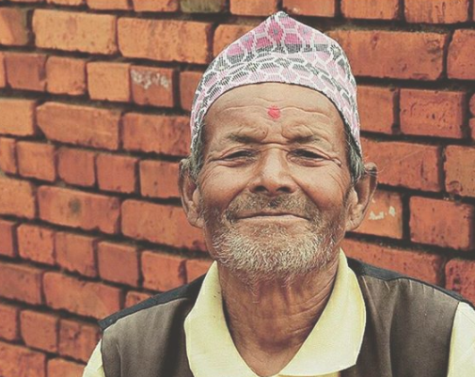
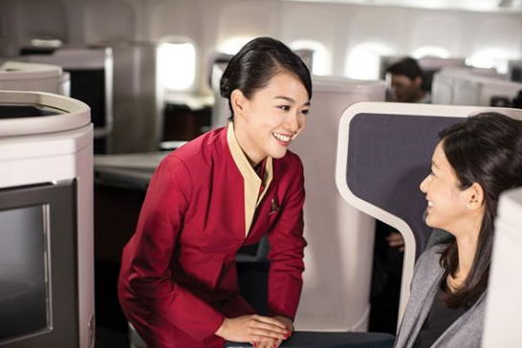
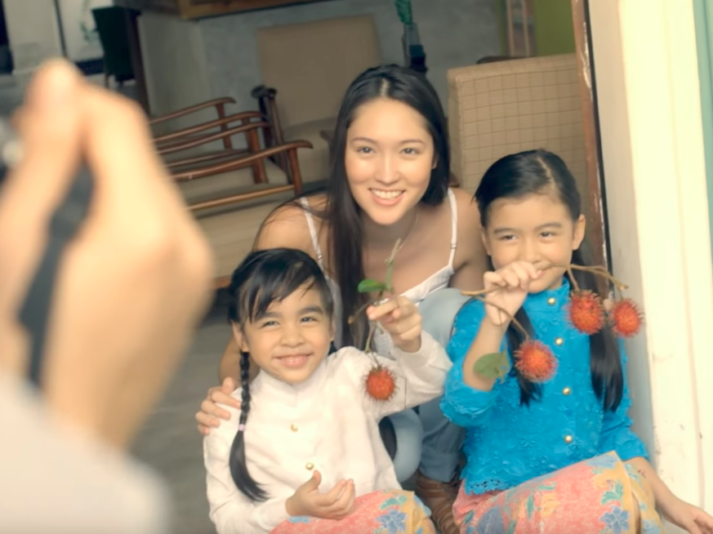
Your Personalized Flight
#lifewelltravelled

Slide 2
Personable Service
Considered Design
Your needs matters. Therefore, we personalize.

Slide 3
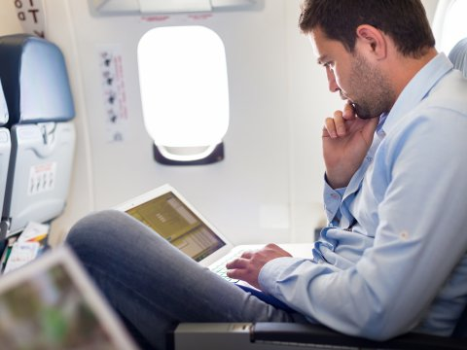
Work Flyers

Slide 4
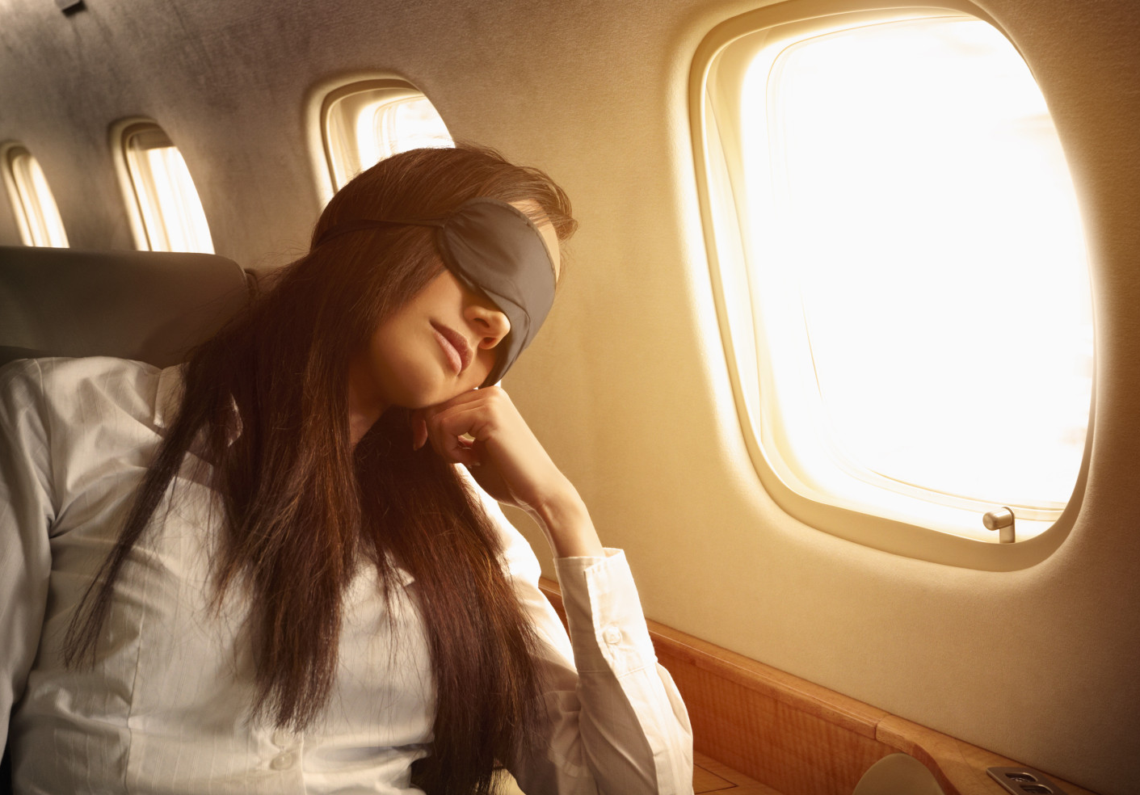
Sleep Flyers

Slide 5
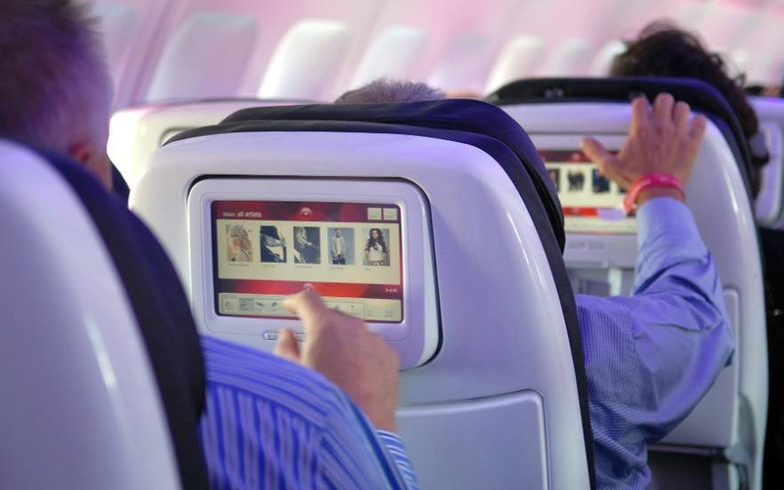
Standard Flyers

Slide 6
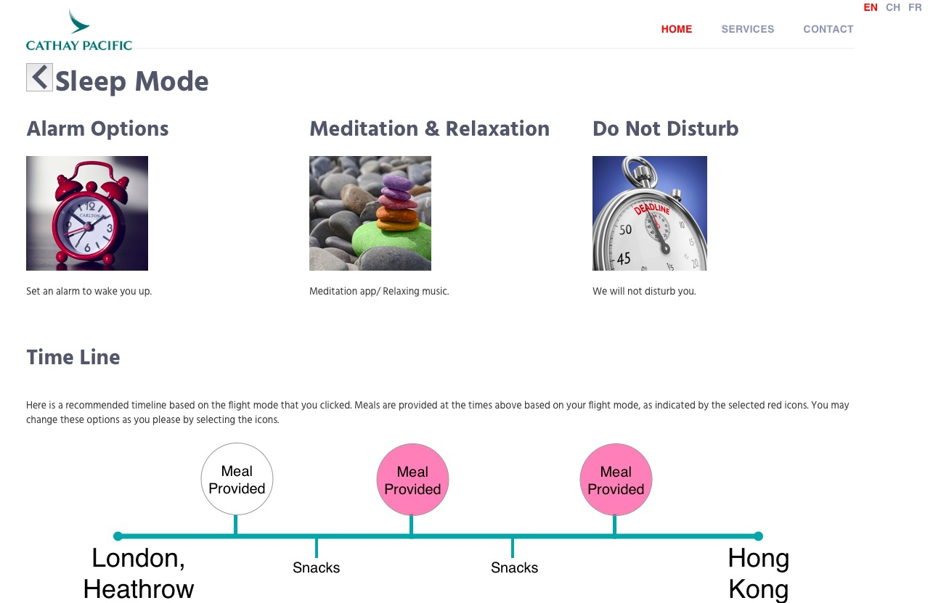

Slide 7

Business Value
Improved Experience
Strengthen Reputation
More Customers
Higher efficiency
Boost Revenue

